Slide 1

Department of Computer Science, CUI Lahore Campus
Formal Methods in Software Engineering
By
Farooq Ahmad

Slide 2
Sequences
Sequence data type, sequences and operators

Slide 3
















Topics covered
Sequences
Sequence data type
Declaring sequence variable
Operators for sequence variables

Slide 4
Need of sequences
Sets are unordered collections; it is not meaningful to speak of the first or last element in a set, or whether one element follows another.
When we write a set, we have to write down the elements in some order, but the ordering we choose is not significant.
In many situations the ordering of elements is significant. These are modelled by the sequence.
Sequences can model arrays, lists, queues, and other sequential structures.
Sequences are notated inside angle brackets.

Slide 5
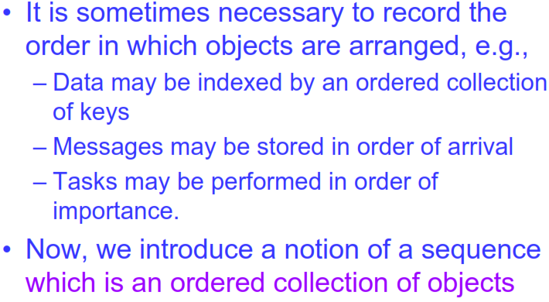
Sequences

Slide 6
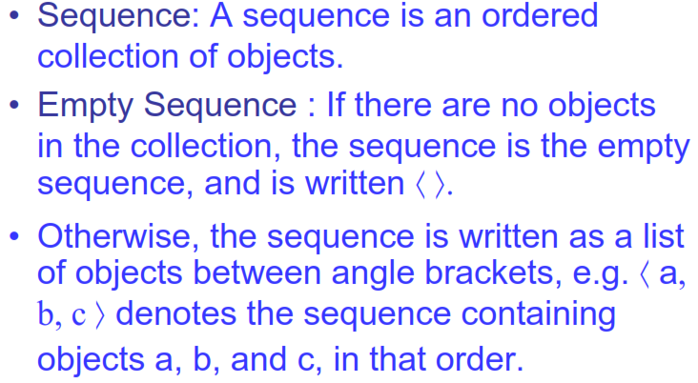
Introduction

Slide 7
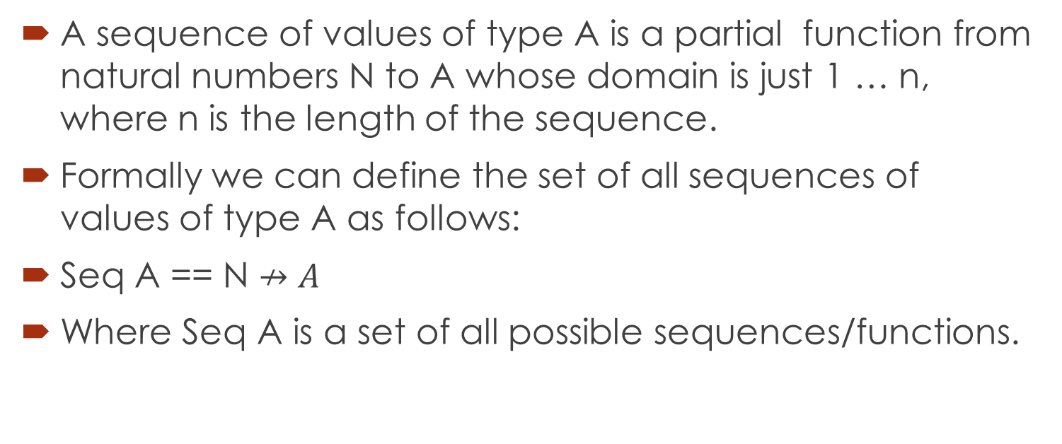
Constructing sequence data type
A sequence of values of type A is a partial function from natural numbers N to A whose domain is just 1 … n, where n is the length of the sequence.
Formally we can define the set of all sequences of values of type A as follows:
Seq A == N $↛A$
Where Seq A is a set of all possible sequences/functions.

Slide 8
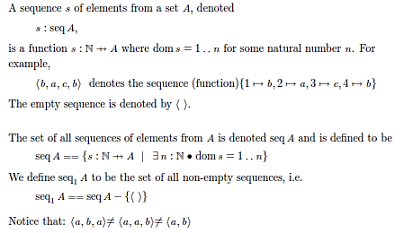
Declaring sequence variable

Slide 9
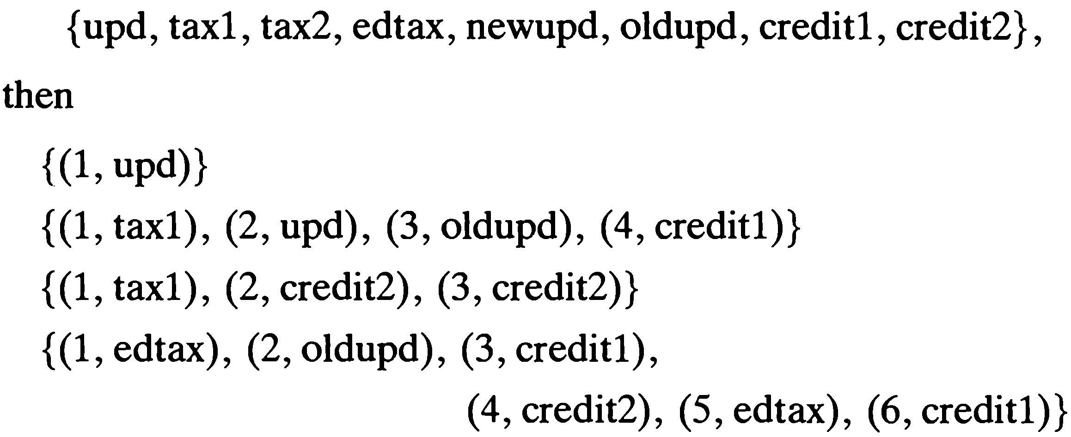
Example
A sequence of type A is a partial function from N to A where the domain of the function is of the form 1..n.
For example, if files is the set
= < upd >
= < tax1, upd, oldudp, credit1 >
= < tax1, credit2, credit2, >
= < edtax, oldupd, credit1, credit2, edtax, credit1 >

Slide 10
Sequence operators
Sequences are just functions whose domains are consecutive numbers, starting with one.
Since sequences are just functions, operators defined for functions also apply to sequences, including function application itself.
weekday 3 = Wednesday

Slide 11
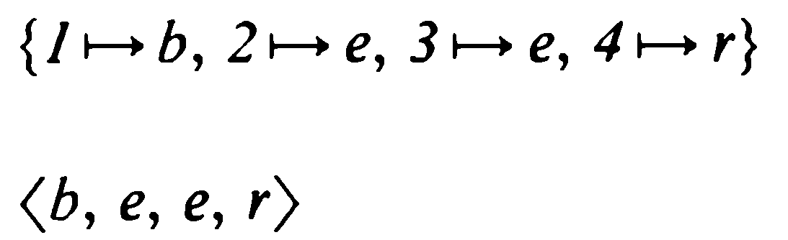
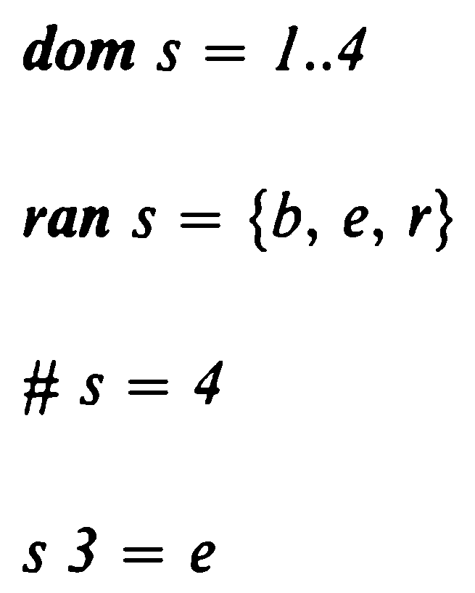
















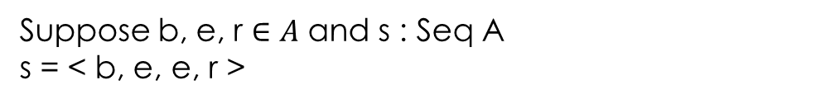




Example
Suppose b, e, r $∈A$ and s : Seq A
s = < b, e, e, r >

Slide 12
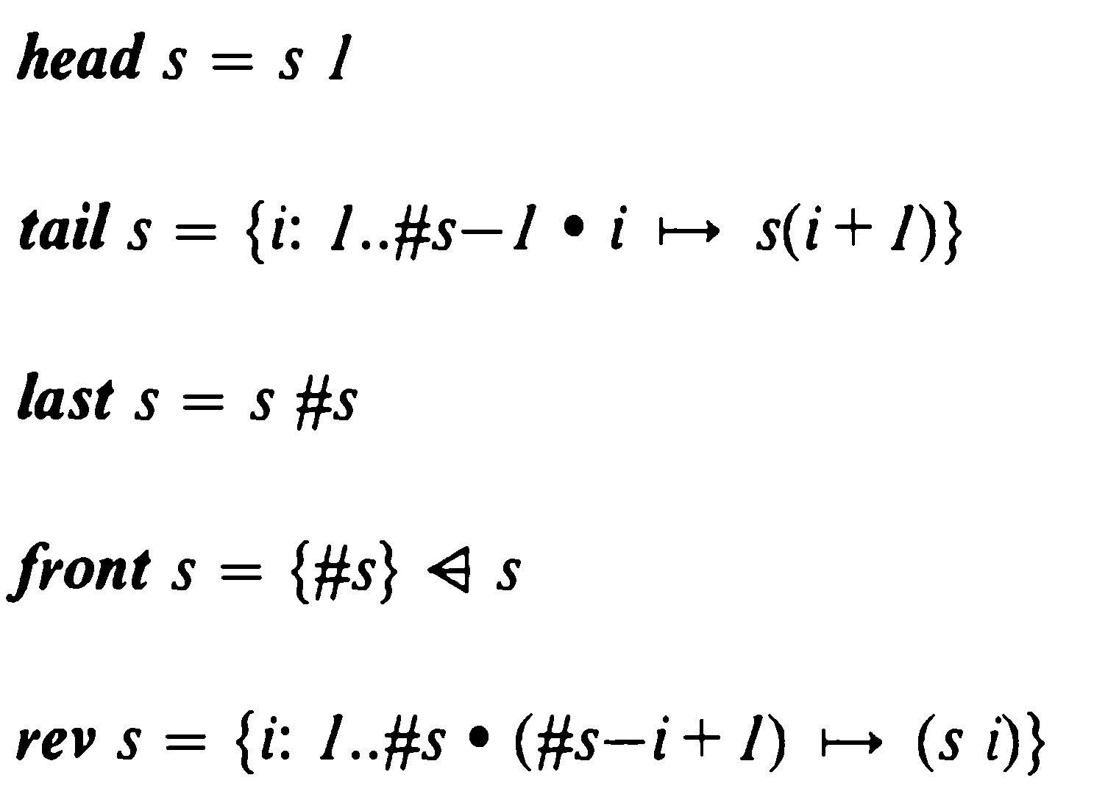
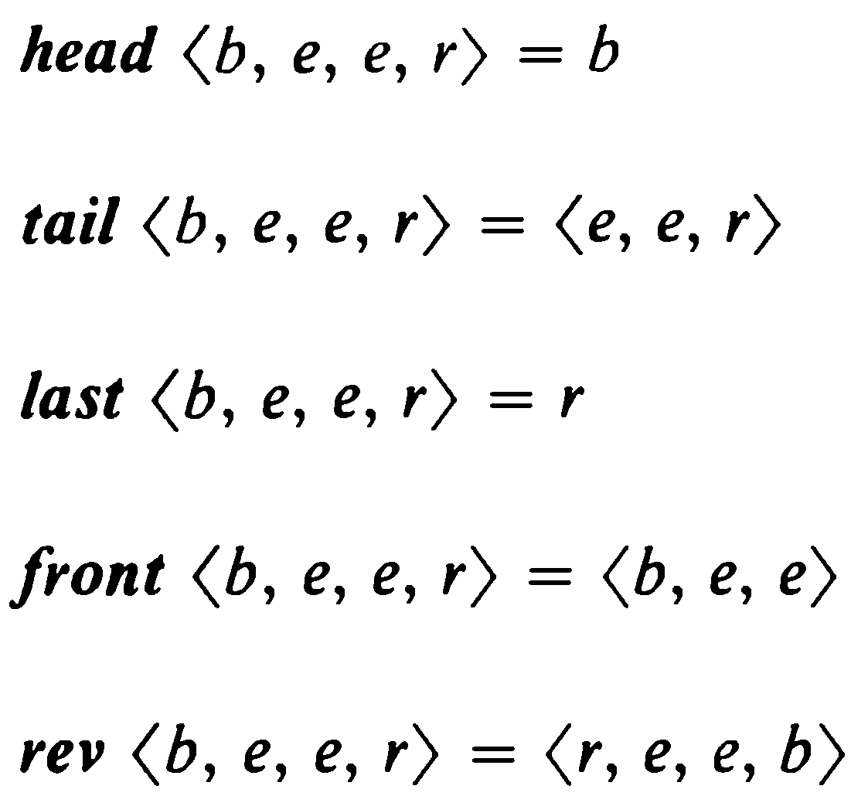






Operators for sequences

Slide 13

Concatenation operator: Example 1

Slide 14
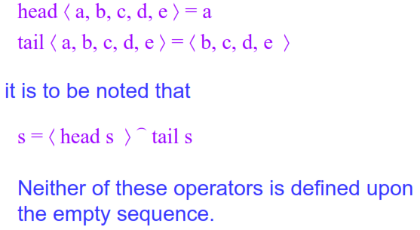
Example 2

Slide 15
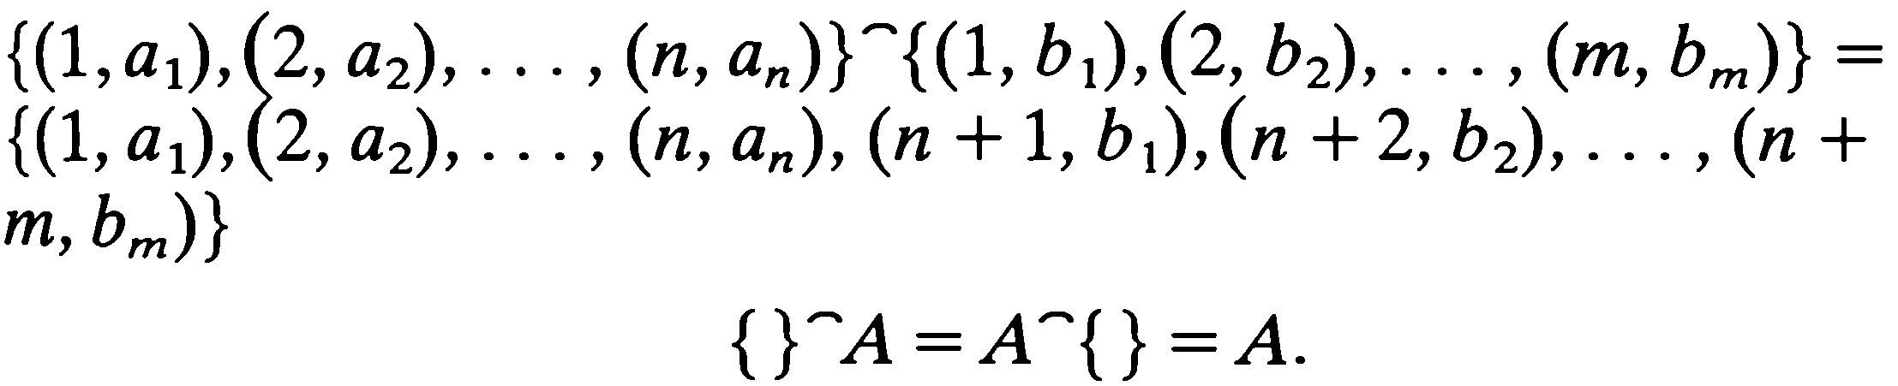
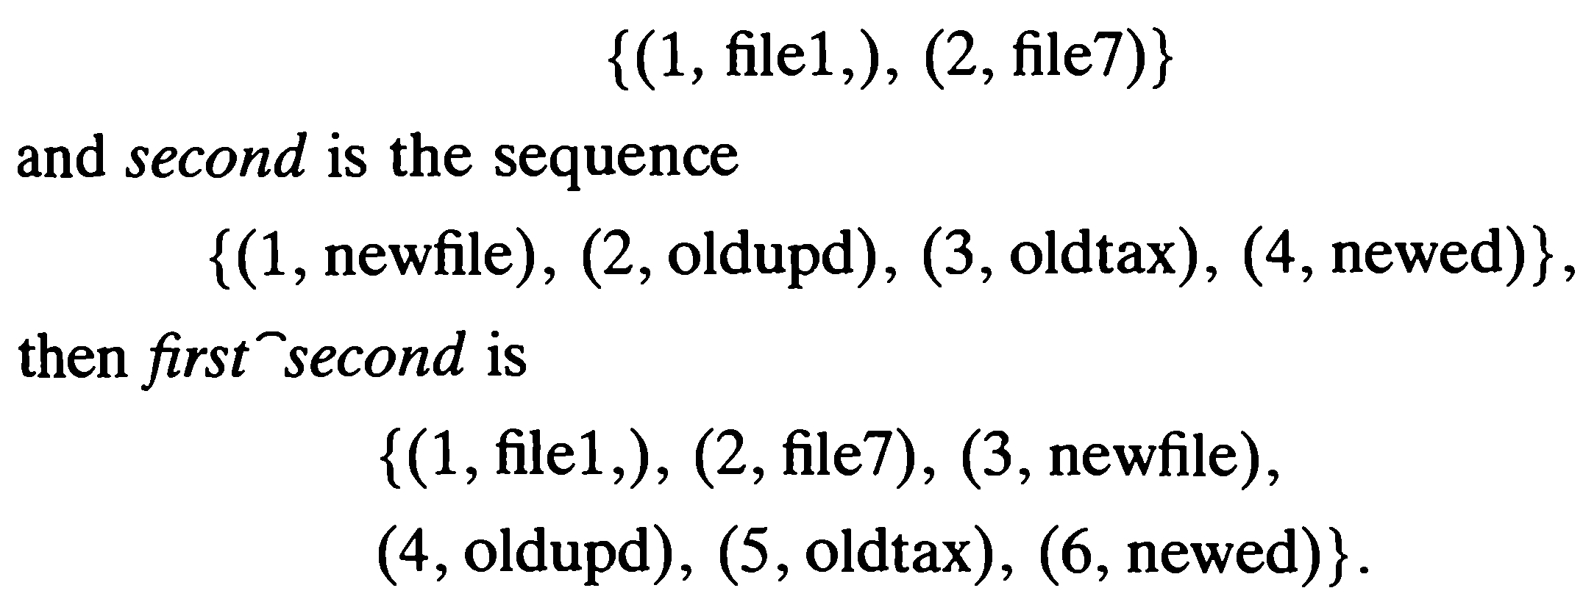
Example 3

Slide 16
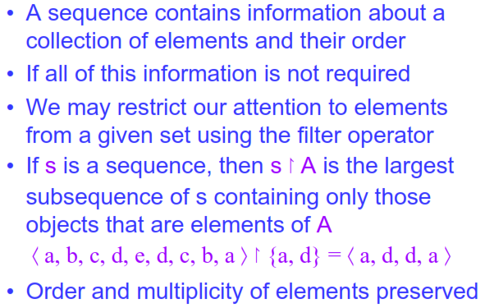
Filter operator

Slide 17
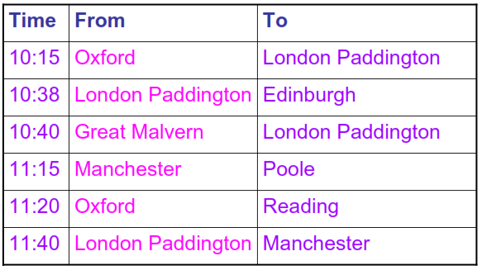
Example: destination board at railway station

Slide 18
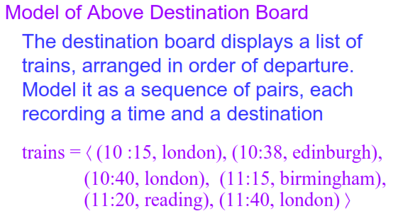
Example

Slide 19
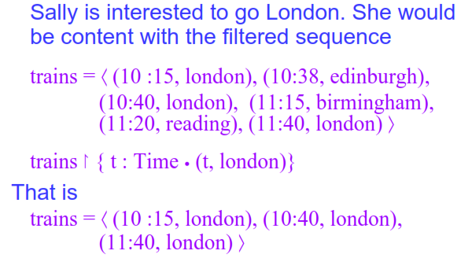
Example continued

Slide 20
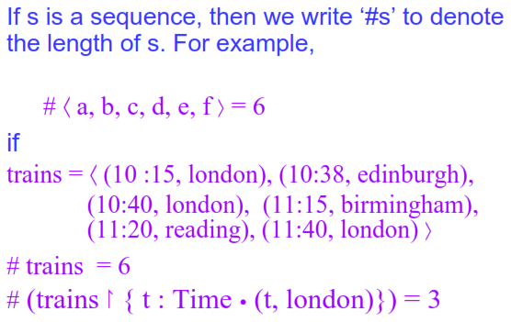
Example continued

Slide 21
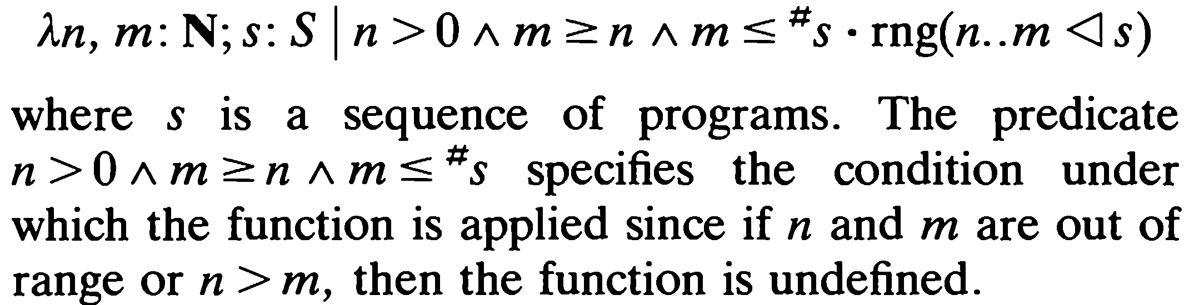















Example
A system specification for an operating system requires that the computer operator be able to remove the nth to mth entries in a queue of programs awaiting execution. Define a function using lambda notation which, when applied to a sequence of programs, gives the set of nth to mth programs.
Answer:

Slide 22
Summary of the lecture: Conclusion
Concept of sequences in Z
Sequence data type
Declaring sequences
Operators for sequences

Slide 23
Reference and reading material
Chapter 4: Section 4.3 of the book “Software development with Z”

